Slide 1
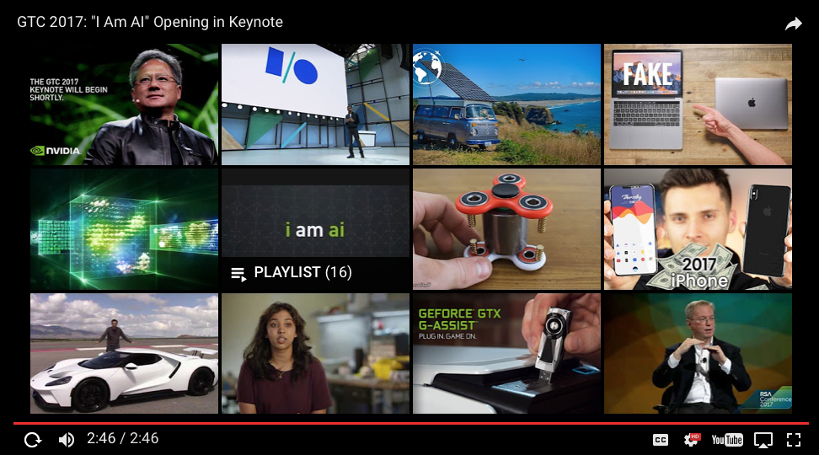
Artificial Intelligence

Slide 2
Disclaimer
The topics covered here are in reference to lot of research work that has been published by notable researchers in the field of artificial intelligence.
The accuracy of the information and historical facts has been collected from various references and are accurate to the best known.
The Videos and conent referenced here are publicly available.

Slide 3
Fantasy or Reality

Slide 4
Mobile First -> AI First
Looking to the future, the next big step will be for the very concept of the “device” to fade away. Over time, the computer itself—whatever its form factor—will be an intelligent assistant helping you through your day. We will move from mobile first to an AI first world. – Sundar Pichai (Founders Letter, 2016)
Notes:
https://blog.google/topics/inside-google/this-years-founders-letter/
https://www.androidheadlines.com/2017/04/google-transitioning-ai-first-company-ceo-says.html

Slide 5

The Last Wave
“There's always a next wave,” Waxman said, noting that corporate computing has already gone from mainframes to client-server and now on to cloud computing. “I firmly believe this is not only the next wave but something that will dwarf the last wave.” – Intel Vice President on Nervana Acquisition a 48 person startup for $400 million, July 2016

Slide 6

Gartner
The world is becoming an intelligent, digitally enabled mesh of people, things and services. Ordinary people will experience a digitally enabled world where the lines between what's real and what's digital truly blur. AI and machine learning will be used to enhance analytics, actions and interfaces of nearly every technology-enabled system. New digital business models are emerging, and new ecosystems are forming to realign business and customer relationships.

Slide 7
Gartner Strategic Technology Trends - 2017
Notes:
http://www.gartner.com/smarterwithgartner/gartners-top-10-technology-trends-2017/

Slide 8

IDC – Cognitive/AI Market Share
Worldwide Cognitive Systems and Artificial Intelligence Revenues Forecast to Surge Past $47 Billion in 2020, According to New IDC Spending Guide.. cognitive/AI solutions will experience a compound annual growth rate (CAGR) of 55.1% over the 2016-2020 forecast period.
Notes:
http://www.businesswire.com/news/home/20161026005031/en/Worldwide-Cognitive-Systems-Artificial-Intelligence-Revenues-Forecast

Slide 9
What Is Ai
=
Notes:
Interestin

Slide 10
Artificial Intelligence
Artificial Intelligence is the ability for machines to learn and understand Data, Events, Sensory Inputs without explicitly computing/programming. It is intelligence where machines mimics or excels human capacity to interact with the environment in an independent way without explicit instructions.
A general learning paradigm to mimic human’s ability, inspired by Animal/Human Brain

Slide 11
AI - > Deep Learning
Artificial Intelligence is the general term used to define Intelligent Systems
Deep Learning is a set of Algorithms that make Artificial Intelligent Systems

Slide 12
Deep Learning
It a deeply stacked layer of Neural Networks
Neural Networks are Biologically inspired.

Slide 13
Deep Learning
Notes:
Deep Learning
Biologically inspired by the brain and neurons
Deep Learning are stacked Layers of Neural Layers
Neural layers
https://en.wikipedia.org/wiki/Turing_test
Frank Rosenblatt’s Perceptron
http://psycnet.apa.org/index.cfm?fa=buy.optionToBuy&id=1959-09865-001
A psychologist, Rosenblatt conceived of the Percetron as a simplified mathematical model of how the neurons in our brains operate: it takes a set of binary inputs (nearby neurons), multiplies each input by a continuous valued weight (the synapse strength to each nearby neuron), and thresholds the sum of these weighted inputs to output a 1 if the sum is big enough and otherwise a 0 (in the same way neurons either fire or do not). Most of the inputs to a Perceptron are either some data or the output of another Perceptron, but an extra detail is that Perceptrons also have one special ‘bias’ input, which just has a value of 1 and basically ensures that more functions are computable with the same input by being able to offset the summed value. This model of the neuron built on the work of Warren McCulloch and Walter Pitts Mcculoch-Pitts
, who showed that a neuron model that sums binary inputs and outputs a 1 if the sum exceeds a certain threshold value, and otherwise outputs a 0, can model the basic OR/AND/NOT functions. This, in the early days of AI, was a big deal - the predominant thought at the time was that making computers able to perform formal logical reasoning would essentially solve AI
Biological motivation and connections
The basic computational unit of the brain is a neuron. Approximately 86 billion neurons can be found in the human nervous system and they are connected with approximately 10^14 - 10^15 synapses. The diagram below shows a cartoon drawing of a biological neuron (left) and a common mathematical model (right). Each neuron receives input signals from its dendrites and produces output signals along its (single) axon. The axon eventually branches out and connects via synapses to dendrites of other neurons. In the computational model of a neuron, the signals that travel along the axons (e.g. x0x0) interact multiplicatively (e.g. w0x0w0x0) with the dendrites of the other neuron based on the synaptic strength at that synapse (e.g. w0w0). The idea is that the synaptic strengths (the weights ww) are learnable and control the strength of influence (and its direction: excitory (positive weight) or inhibitory (negative weight)) of one neuron on another. In the basic model, the dendrites carry the signal to the cell body where they all get summed. If the final sum is above a certain threshold, the neuron can fire, sending a spike along its axon. In the computational model, we assume that the precise timings of the spikes do not matter, and that only the frequency of the firing communicates information. Based on this rate code interpretation, we model the firing rate of the neuron with an activation function ff, which represents the frequency of the spikes along the axon. Historically, a common choice of activation function is the sigmoid function σ, since it takes a real-valued input (the signal strength after the sum) and squashes it to range between 0 and 1. We will see details of these activation functions later in this section.

Slide 14
The Mark I Perceptron

Slide 15
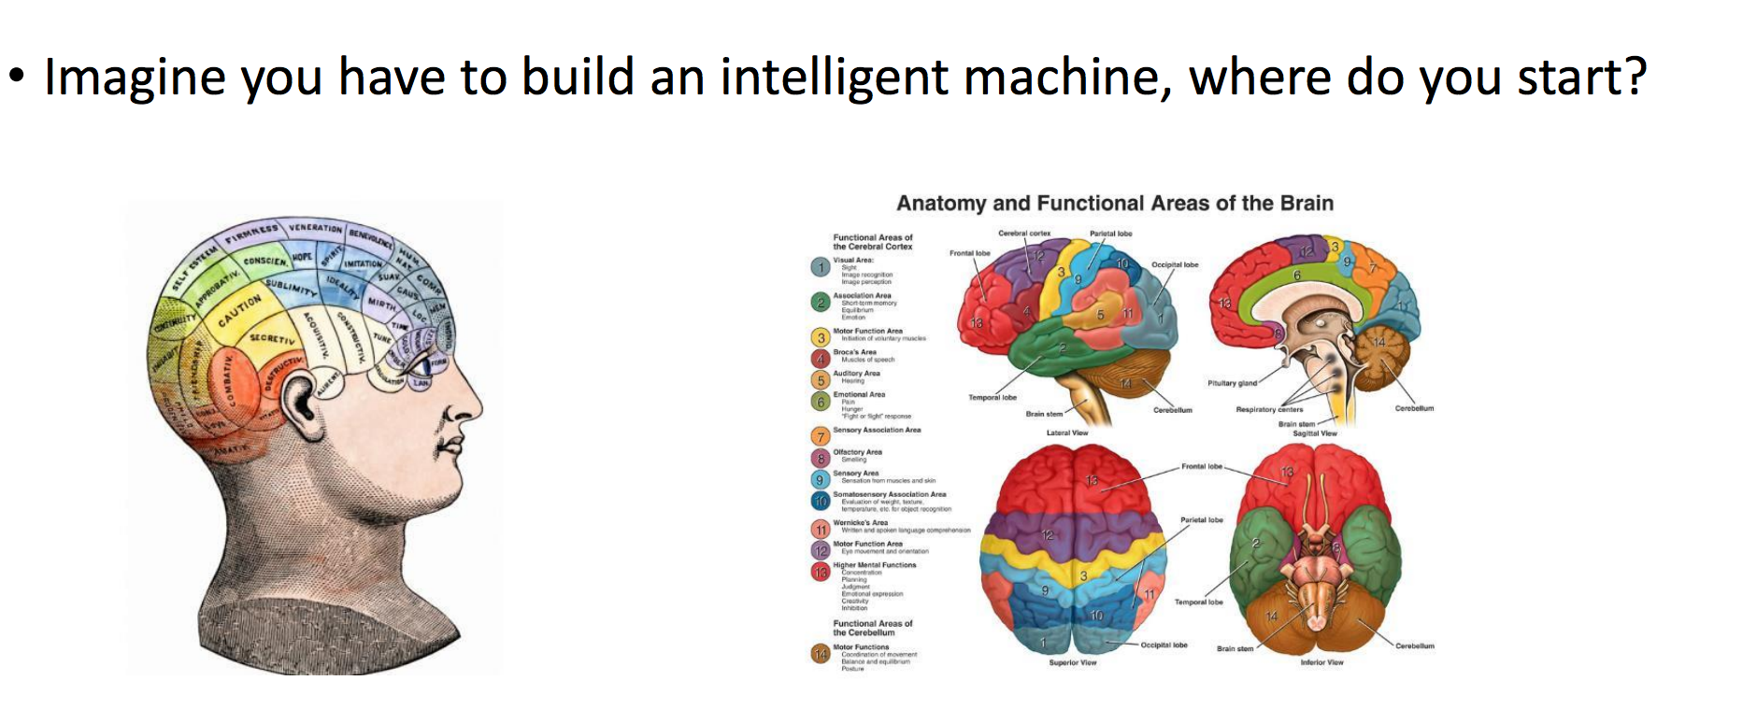
Brain Inspired – Intelligent Machines

Slide 16

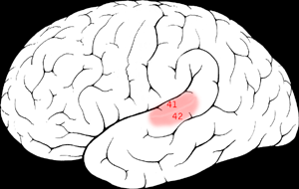

The “one learning algorithm” hypothesis
Auditory Cortex
Auditory cortex learns to see
[Roe et al., 1992]

Slide 17
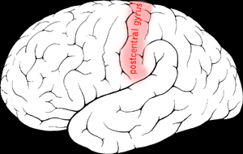

The “one learning algorithm” hypothesis
Somatosensory Cortex
Somatosensory cortex learns to see
[Metin & Frost, 1989]

Slide 18
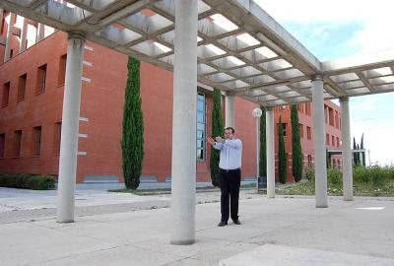
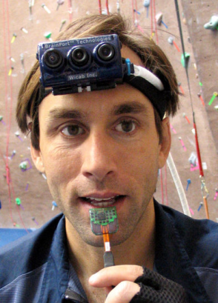
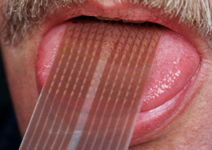
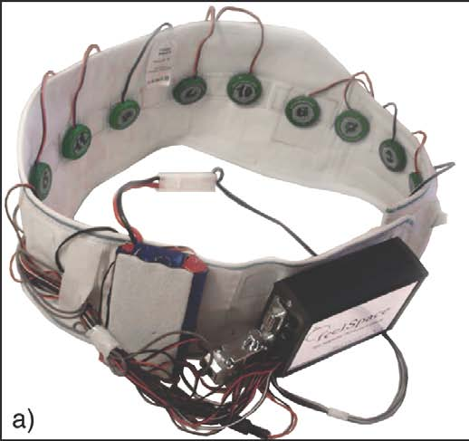
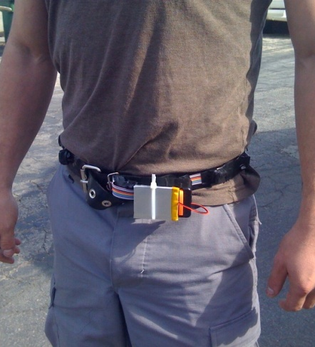
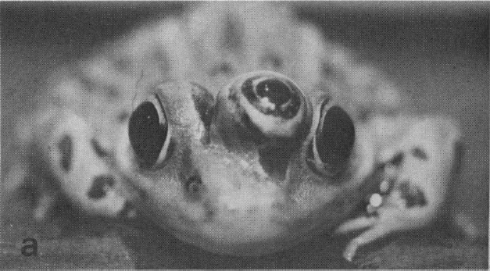
Sensor representations in the brain
Seeing with your tongue
Human echolocation (sonar)
Haptic belt: Direction sense
Implanting a 3rd eye
[BrainPort; Welsh & Blasch, 1997; Nagel et al., 2005; Constantine-Paton & Law, 2009]

Slide 19
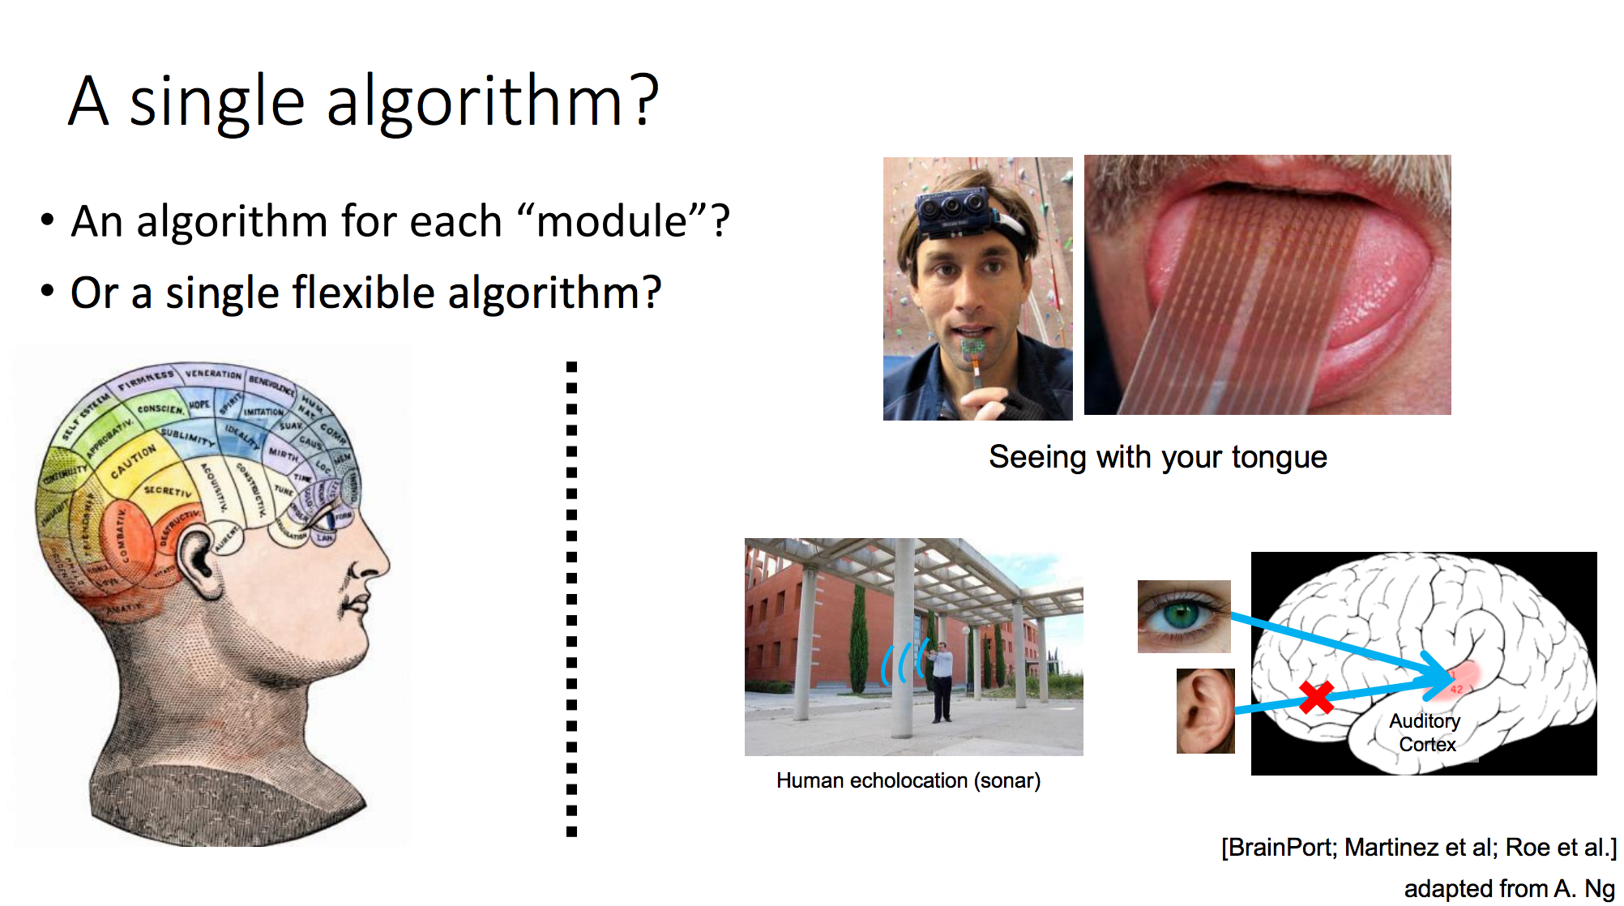
Single Learning Algorithms

Slide 20
Historical Perspective

Slide 21
History
Ref - http://beamandrew.github.io/deeplearning/2017/02/23/deep_learning_101_part1.html
Notes:
The idea of creating a ‘thinking’ machine is at least as old as modern computing, if not even older.
Alan Turing in his seminal paper ‘Computing Machinery and Intelligence’ laid out several criteria to asses whether a machine could be said be intelligent, which has since become known as the ‘Turing test’.
For some great explorations on variants of the Turing test, check-out Brain Christian’s book detailing his adventures with the Loebner Prize entitled The Most Human Human or check the amazing, dramatized version in Ex-machina.
Alan Turing[edit]
Researchers in the United Kingdom had been exploring "machine intelligence" for up to ten years prior to the founding of the field of artificial intelligence (AI) research in 1956.^{[14]} It was a common topic among the members of the Ratio Club, who were an informal group of British cybernetics and electronics researchers that included Alan Turing, after whom the test is named.^{[15]}
Turing, in particular, had been tackling the notion of machine intelligence since at least 1941^{[16]} and one of the earliest-known mentions of "computer intelligence" was made by him in 1947.^{[17]} In Turing's report, "Intelligent Machinery",^{[18]} he investigated "the question of whether or not it is possible for machinery to show intelligent behaviour"^{[19]} and, as part of that investigation, proposed what may be considered the forerunner to his later tests:
Minsky
Along with the double-PhD wielding Seymor Papert, Minksy wrote a book entitled Perceptrons that effectively killed the perceptron, ending embryonic idea of a neural net. They showed that the perceptron was incapable of learning the simple exclusive-or (XOR) function. Worse, they proved that it was theoretically impossible for it to learn such a function, no matter how long you let it train. Now this isn’t surprising to us, as the model implied by the perceptron is a linear one and the XOR function is nonlinear, but at the time this was enough to kill all research on neural nets and usher in the first AI winter.
Geoffery Hinton George Bool’s great-great-grandson, a man by the name of Geoff Hinton, finished his PhD studying neural networks in 1978 and by 1986 had moved to the institute for cognitive science at UC San Diego. Along with David Rumelhart and Ronald Williams, Hinton published a paper entitled “Learning representations by back-propagating errors”.
The algorithm works by taking the derivative of the network’s loss function and back-propagating the errors to update the parameters in the lower layers, hence the common moniker backprop. Though Rumelhart, Hinton and Williams are often credited for inventing backprop, this is disputed by some. There is something of a long standing controversy between the deep learning “conspiracy” of Geoff Hinton /Yann Lecun/Yoshua Bengio and Jürgen Schmidhuber as to who should actually be credited with several key developments, but that’s an issue best left tabled for now.
This algorithm lead to some early successes, notably in training convoluational neural nets (aka CNNs, also referred to using the less pronounceable convnets) to recognize handwritten digits, a project which was speared headed by Yann Lecun at AT&T Bell Labs.
Geoff Hinton on Deep Learning (Interesting video on challenges he faced)
https://www.youtube.com/watch?v=uAu3jQWaN6E
Around 2006, Hinton once again declared that he knew how the brain works, and introduced the idea of unsupervised pretraining and deep belief nets

Slide 22
Modern Success
2006 - The idea was to train a simple 2-layer unsupervised model like a restricted boltzman machine, freeze all the parameters, stick on a new layer on top and train just the parameters for the new layer. – Geoff Hinton.
2012 – Alex Krizhevsky, Ilya Sutskever, and Geoff Hinton entered a submission that would halve the existing error rate to 16%
Notes:
You would keep adding and training layers in this greedy fashion until you had a deep network, and then use the result of this process to initialize the parameters of a traditional neural network.
Using this strategy, people were able to train networks that were deeper than previous attempts, prompting a rebranding of ‘neural networks’ to ‘deep learning’
In 2010, a large database known as Imagenet containing millions of labeled images was created and published by Fei-Fei Li’s group at Stanford
In the first two years of the contest, the top models had error rates of 28% and 26%. In 2012, Alex Krizhevsky, Ilya Sutskever, and Geoff Hinton entered a submission that would halve the existing error rate to 16%. The model combined several critical components that would go one to become mainstays in deep learning models.
Interesting lecture by Yann LeCunnss
https://www.bell-labs.com/var/articles/yann-lecun-predictive-learning-next-frontier-ai-february-17-2017/

Slide 23
Modern Success

Slide 24
ILSRVC – Imagenet
Notes:
http://www.image-net.org/

Slide 25
Reasons for Success
Vast amounts of Data
GPUs
Google’s Famous cat experiment
Took $1 million in 2013
$20,000 GPU
*There is a big race in the Chip Market to get better CPUs
Faster Back Propagation
Better Activation Functions
RELU vs Sigmoid

Slide 26
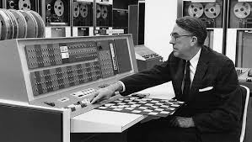
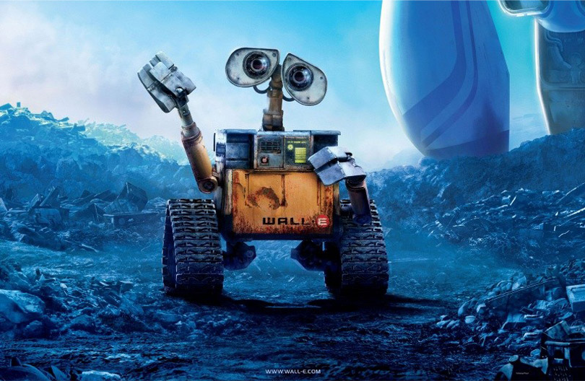
Machine Learning
Arthur Samuel (1959) – Machine Learning: Field of Study that gives the ability to learn without being explicitly programmed.
Checker Programmer

Slide 27
Use Cases

Slide 28
Use Cases
If you're trying to understand AI's near-term impact, don't think "sentience." Instead think "automation on steroids.”

Slide 29
Why Deep Learning
Accuracy
Lack of Need for Feature Engineering
Generic Framework – Has done much better than Hand Crafted Features
AlphaGo – Defeated Lee Sedol (9 time Dan of Go)
Go is more complicated than Chess (Deep Blue)
Watson defeated Jeopardy (2011) – Very specialized
2017 rematch on May 22-24.
Ran on Single TPU and defeated Ke Jie

Slide 30
Machine Learning in Industry Movement
Statistical Learning (SAS)/HPC
Big Data ( Spark MLLib/Mahout)
Deep Learning/AI

Slide 31
Categories of Machine Learning
Supervised
Most Success
Train with Labelled Data and then you predict
Covered more later
Unsupervised
Holy Grail – Hardest Problem to Solve
Reinforcement Learning
Success with Games, Robotics, Simulations

Slide 32
From data to decisions and actions
Data
Recommendations
What should I do?
Decision
Action
Decision automation
Decision support
Predictions
What will happen?
Interactive dashboards
Why did it happen?
Static reports
What happened?
Manual process
Value
Notes:
Azure ML aims to transform your data in to an intelligent action

Slide 33
Machine Learning - Personas
ML Algorithms
Best of Computer Scientist
ML Studio
Data Scientist
ML Operationalization
IT Professional
ML APIs Marketplace
ISVs & Developers

Slide 34
Machine Learning Ecosystem
Deploy as Web Service
Publish Web Service
Provision Workspace
Build ML Model
Publish an App
Get/Prepare Data
Get Qubole Subscription
Create Cluster
Evaluate Model Results
Build/Edit Experiment
Customer Integrate with App/Analytics
Create/Update Model
Publish the model

Slide 35
Steps to Build a Machine Learning Solution
1
Problem Framing
2 Get/Prepare Data
3
Develop Model
4
Deploy Model
5
Evaluate / Track Performance
3.1
Analysis/ Metric definition
3.2
Feature Engineering
3.3
Model Training
3.4
Parameter Tuning
3.5
Evaluation

Slide 36

Example use cases
Finance and risk
Sales and marketing
Customer and channel
Operations and workforce
Revenue Forecasting
Sales forecasting
User segmentation
Agent allocation
$$$
Portfolio optimization
Demand forecasting
Personalized offers
Warehouse efficiency
Investment modelling
Sales lead scoring
Product recommendation
Smart buildings
$$$
Fraud detection
Marketing mix optimization
Predictive maintenance
Risk management
Supply chain optimization
Notes:
Many examples of predictive analytics can be found literally everywhere today in our society:
Spam/junk email filters These are based on the content, headers, origins, and even user behaviors (for example, always delete emails from this sender).
Mortgage applications Typically, your mortgage loan and credit worthiness is determined by advanced predictive analytic algorithm engines.
Various forms of pattern recognition These include optical character recognition (OCR) for routing your daily postal mail, speech recognition on your smart phone, and even facial recognition for advanced security systems.
Life insurance Examples include calculating mortality rates, life expectancy, premiums, and payouts.
Medical insurance Insurers attempt to determine future medical expenses based on historical medical claims and similar patient backgrounds.
Liability/property insurance Companies can analyze coverage risks for automobile and home owners based on demographics.
Credit card fraud detection This process is based on usage and activity patterns. In the past year, the number of credit card transactions has topped 1 billion. The popularity of contactless payments via near-field communications (NFC) has also increased dramatically over the past year due to smart phone integration.
Airline flights Airlines calculate fees, schedules, and revenues based on prior air travel patterns and flight data.
Web search page results Predictive analytics help determine which ads, recommendations, and display sequences to render on the page.
Predictive maintenance This is used with almost everything we can monitor: planes, trains, elevators, cars, and yes, even data centers.
Health care Predictive analytics are in widespread use to help determine patient outcomes and future care based on historical data and pattern matching across similar patient data sets.

Slide 37
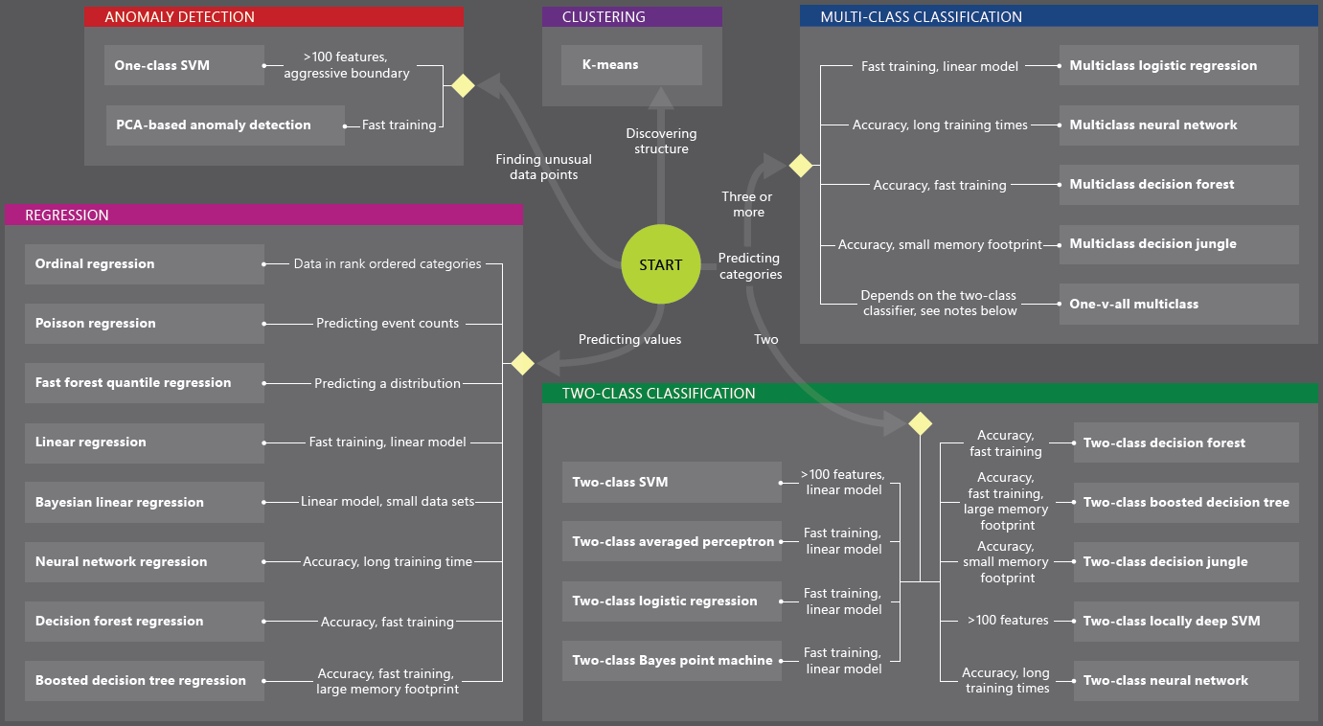

Slide 38
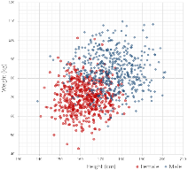
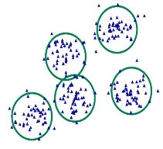
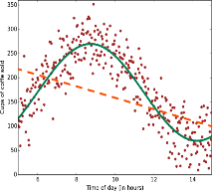
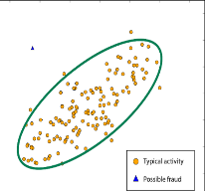
Common Classes of Algorithms (Supervised|Unsupervised)
Classification
Clustering
Regression
Anomaly Detection
Notes:
More samples on: https://azure.microsoft.com/en-us/documentation/articles/machine-learning-algorithm-choice/
Mention about Classification, Regression etc.

Slide 39
Why you need to know these algorithms?
If you want to answer a YES|NO question, it is classification
If you want to predict a numerical value, it is regression
If you want to group data into similar observations, it is clustering
If you want to recommend an item, it is recommender system
If you want to find anomalies in a group, it is anomaly detection
and many other ML algorithms for specific problem

Slide 40
Classification
Scenarios:
Which customer are more likely to buy, stay, leave (churn analysis)
Which transactions|actions are fraudulent
Which quotes are more likely to become orders
Recognition of patterns: speech, speaker, image, movement, etc.
Algorithms: Boosted Decision Tree, Decision Forest, Decision Jungle, Logistic Regression, SVM, ANN, etc.
Classification

Slide 41
Clustering
Scenarios:
Customer segmentation: divide a customer base into groups of individuals that are similar in specific ways relevant to marketing, such as age, gender, interests, spending habits, etc.
Market segmentation
Quantization of all sorts, such as, data compression, color reduction, etc.
Pattern recognition
Algorithms: K-means
Clustering

Slide 42
Regression
Scenarios:
Stock prices prediction
Sales forecasts
Premiums on insurance based on different factors
Quality control: number of complaints over time based on product specs, utilization, etc.
Workforce prediction
Workload prediction
Algorithms: Bayesian Linear, Linear Regression, Ordinal Regression, ANN, Boosted Decision Tree, Decision Forest
Regression

Slide 43
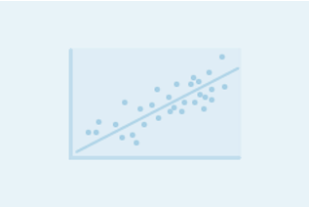

Regression versus Classification
Does your customer want to predict|estimate a number (regression) or apply a label|categorize (classification)?
Regression problems
Estimate household power consumption
Estimate customer’s income
Classification problems
Power station will|will not meet demand
Customer will respond to advertising

Slide 44
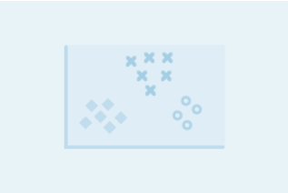
Binary versus Multiclass Classification
Does your customer want a yes|no answer?
Binary examples
click prediction
yes|no
over|under
win|loss
Multiclass examples
kind of tree
kind of network attack
type of heart disease

Slide 45
AI Use Cases
Notes:
From :-
https://hbr.org/2016/11/what-artificial-intelligence-can-and-cant-do-right-now

Slide 46
Challenges to AI
Data. Among leading AI teams, many can likely replicate others’ software in, at most, 1–2 years. But it is exceedingly difficult to get access to someone else’s data. Thus data, rather than software, is the defensible barrier for many businesses.
Talent. Simply downloading and “applying” open-source software to your data won’t work. AI needs to be customized to your business context and data. This is why there is currently a war for the scarce AI talent that can do this work.

Slide 47
Data Collection Challenge
Dataset Labelling Companies have sprung up
Crowdflower – Used by Uber and others
Amazon Mechanical Turk
Multiple Small companies for labelling Street Sign – 3d data

Slide 48
New Use Cases /Applications
Computer Vision
Classification
Identification
Generative Ai
Security
Text Analysis
Better Accuracy than anything before.
Speech Synthesis
Voice to Text – Siri, Baidu
Robotics
Self Driving Car
Notes:
https://www.forbes.com/sites/bernardmarr/2016/09/30/what-are-the-top-10-use-cases-for-machine-learning-and-ai/#27cb9e3494c9
https://deeplearning4j.org/use_cases

Slide 49
Cons of Deep Learning
Lack of Visibility into the functions.
Financial companies are having trouble implementing it as they cannot be audited.
Algorithms work but no really understands why they work
Tuning Algorithms is an art and experiment than real science
Needs deeper knowledge on the algorithms than logic.
Hard to find talented skills

Slide 50
Company | Product | Remarks
Alphabet | Google ML Engine Rest API Based Vision API Video Intelligence API Natural language Translation API Deep Mind Solving Artificial General Intelligence Impact on Healthcare and Data Center Power Consumption Tensor Processing Unit Competing with Nvida Will be offered as a Cloud Service | Company with largest Mindshare in Artificial Intelligence. I think Google will be the biggest competitor in the Cloud Business going forward. https://cloud.google.com/products/
Amazon | Apache Mxnet Similar Rest based API as Google

Slide 51
Competitive Landscape
Company | Product | Remarks
Microsoft | CNTK https://studio.azureml.net/ - A very comprehensive support for Machine Learning Libraries. - A well designed Interface | Azure Cloud is growing very fast. They have actively taken up market share from Amazon
IBM | Watson Power8 PC with NVLink Historic Dominance with Deep Blue (Chess) and | IBM BlueMix IBM to use Watson to Market itself

Slide 52
Framework

Slide 53
Frameworks
Caffe/Caffe2 (UC Berkeley/Facebook)
Theano ( U. of Montreal)
Tensorflow (Google)
Torch (Facebook and Twitter)
Chainer (Japan )
Mxnet (Apache Incubator/Amazon)
Microsoft CNTK
BigDL - Intel

Slide 54
Do Frameworks Matter?
Notes:
Not really
At the end of the day they are all doing Mathemetical processing and implementing the same Algorithms

Slide 55
Framework Selection Criteria
Research Papers on arxiv
Performance and Scalability
Research and Tutorials on Github

Slide 56
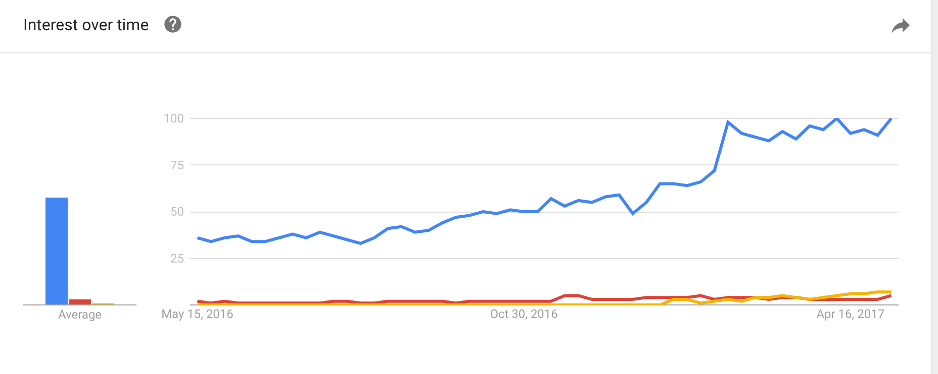

Google Trends DL Frameworks

Slide 57
Topics
Definition
History
Machine Learning vs Deep Learning
Deep Learning Branches
Use Cases
Computer Vision
NLP
Reinforcement learning
Frameworks

Slide 58
Topics
Algorithms
Hadoop and Deep Learning
Hardware
GPU Centered

Slide 59
Computer Vision

Slide 60
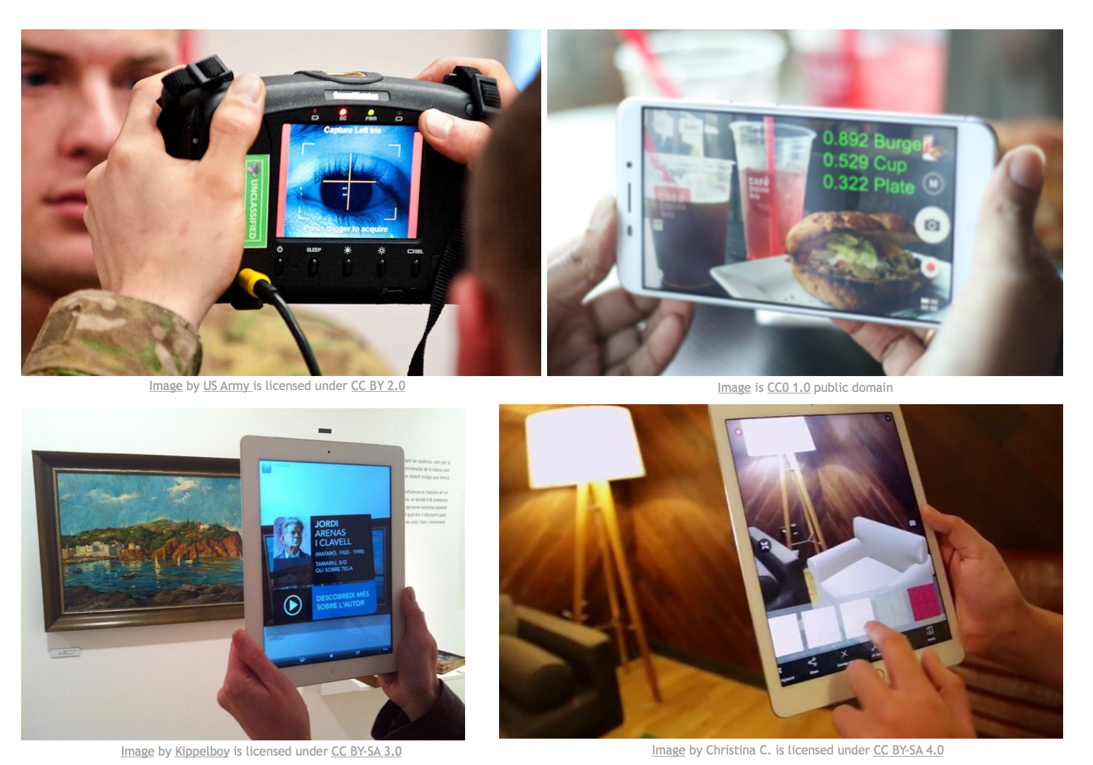
Cameras can See?

Slide 61
Image Classification – CNN Models

Slide 62
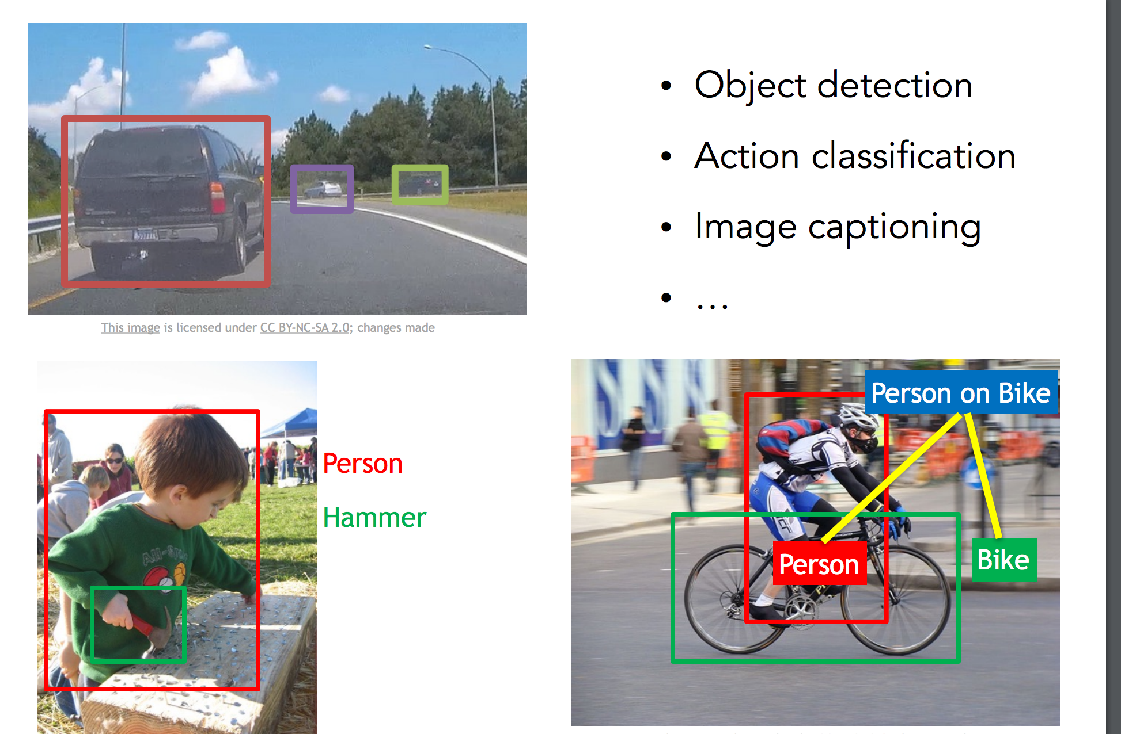
Image Segmentation

Slide 63
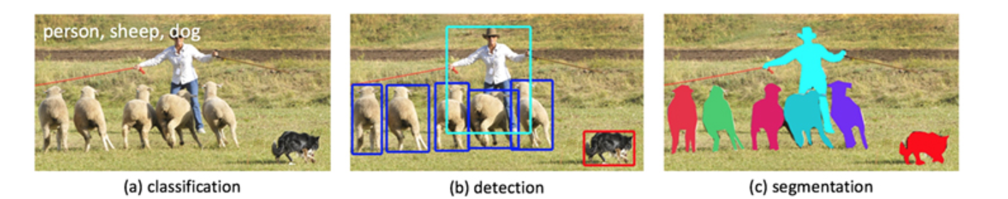
Image Classification/Detection/Segmentation

Slide 64
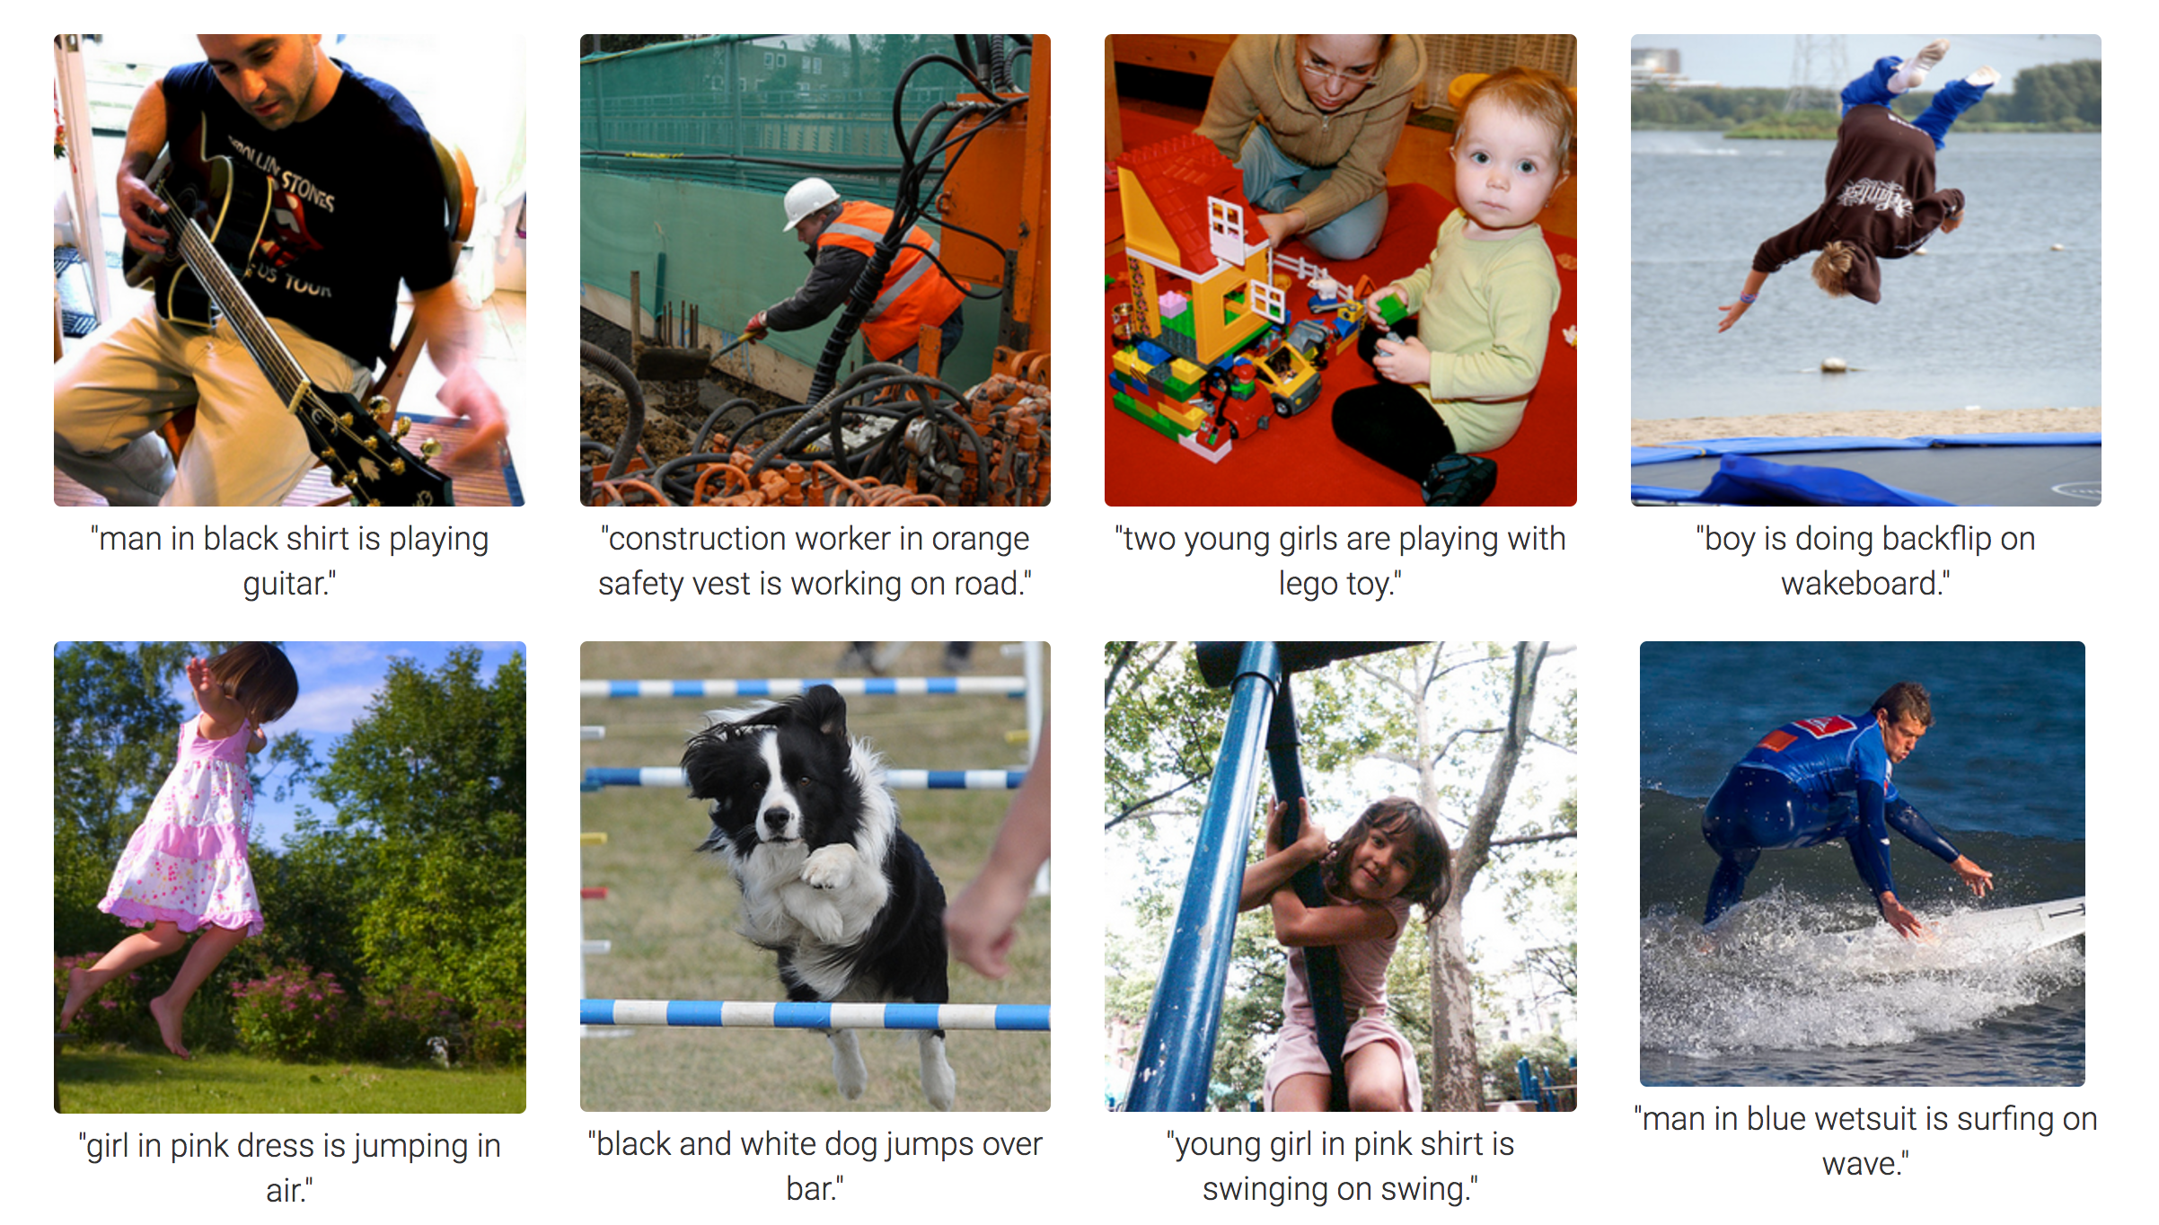
Image to Text

Slide 65
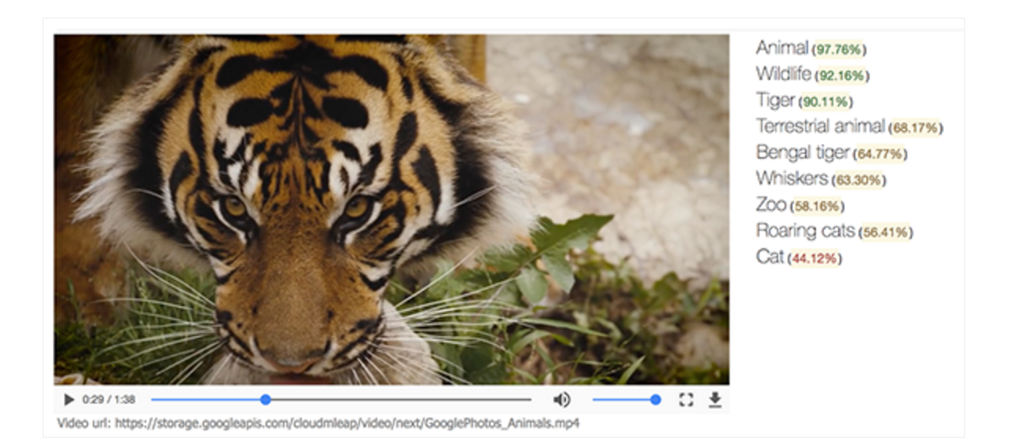
Video to Text

Slide 66
Neural Styles

Slide 67
Generative Adversarial Networks

Slide 68
Sequence Analysis

Slide 69
Recurrent Neural Networks

Slide 70
Natural Language Processing
Machine Translation
Higher Accuracy
Same Model can do multi-language translation without pre-training on every language
Question Answer System
Word Embeddings
Sentence Completions
Speech to Text (Siri)
Text to Speech

Slide 71
Natural Language Processing
Copying Voice and Accents

Slide 72
Self Driving Car

Slide 73
Nvidia – Self Driving Car

Slide 74
Mapping

Slide 75
Robotics

Slide 76
Reinforcement Learning

Slide 77
Deep Reinforcement Learning

Slide 78
